Slide 1
Food Mart
Media Cost Prediction &
Customer Segmentation

Slide 2
Homepage
Project Overview
Summary
About FoodMart
Data Source
Model
Database
Visualization
About Us
Wikipedia
Machine learning codes
GitHub links
Tableau dashboard
Dataset Sample
Filter search
Kaggle dataset
Team member
social media
Code for building tables
GitHub link
New Tables
Stored in GitHub

Slide 3
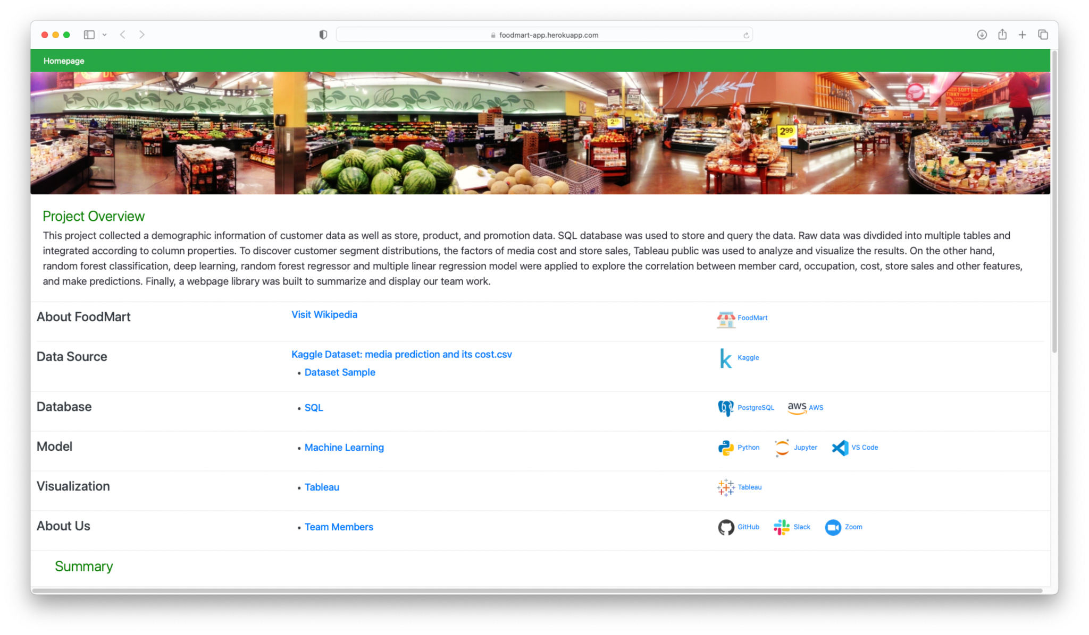
https://foodmart-app.herokuapp.com
Webpage library
Notes:
Good evening, everyone! It’s our honor to present our final project here today.
Our project is about Food Mart convenience store. We created a webpage library to summarize our project.

Slide 4
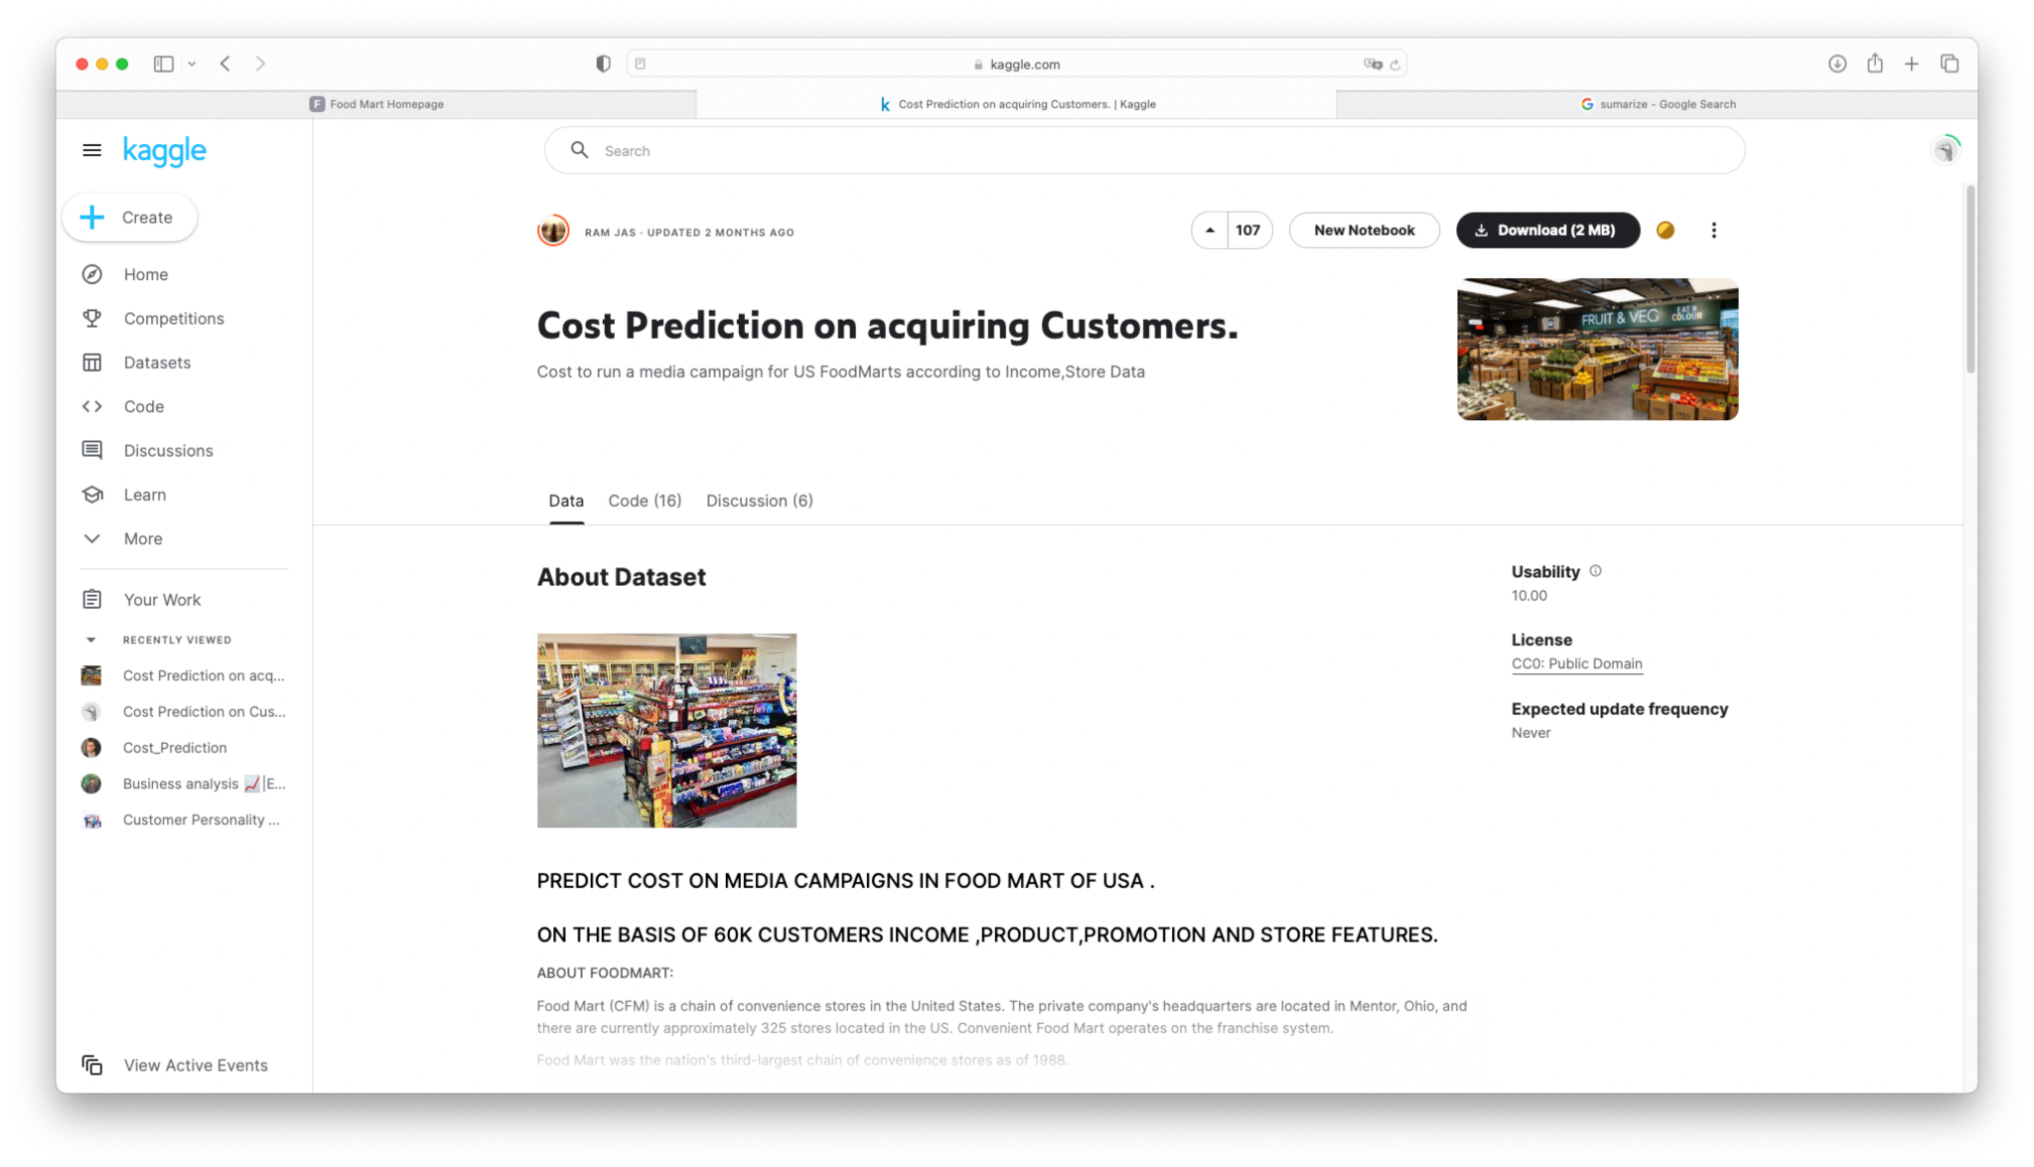
https://foodmart-app.herokuapp.com
Webpage library
Notes:
Our data source comes from kaggle database. Stella will explain why we chose this dataset to do the analyses.

Slide 5
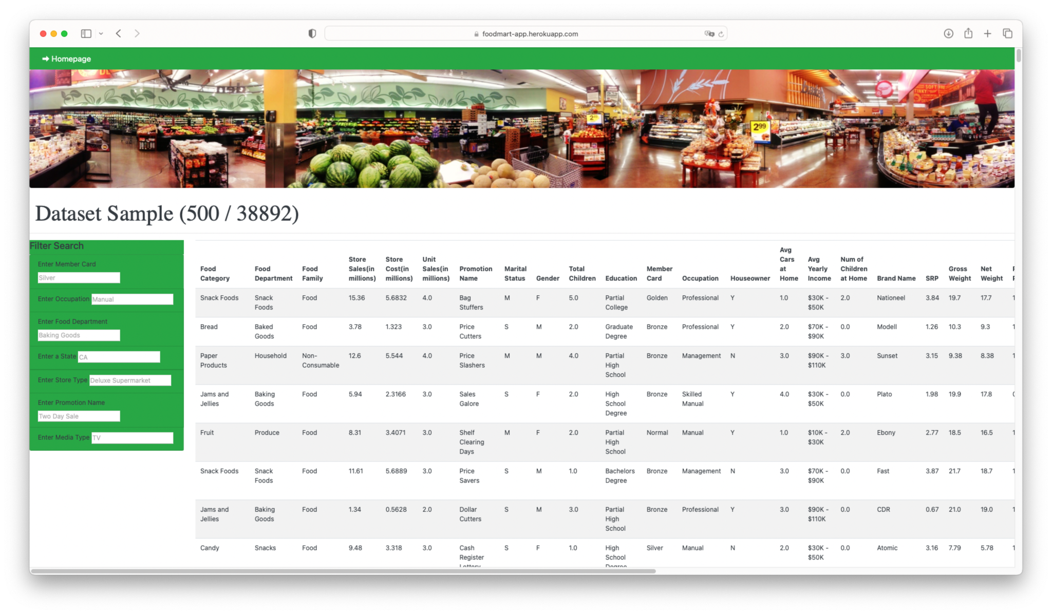
https://foodmart-app.herokuapp.com
Webpage library
Notes:
After filtered with the country to USA, our dataset still have almost 39K rows.
For computer memory saving, let take 500 rows as an example. If you would like to check member card, we can add filter in filter search area to see the result. Also occupation, food department, store type, promotion name, media type are the categorical variables that we focused on.

Slide 6
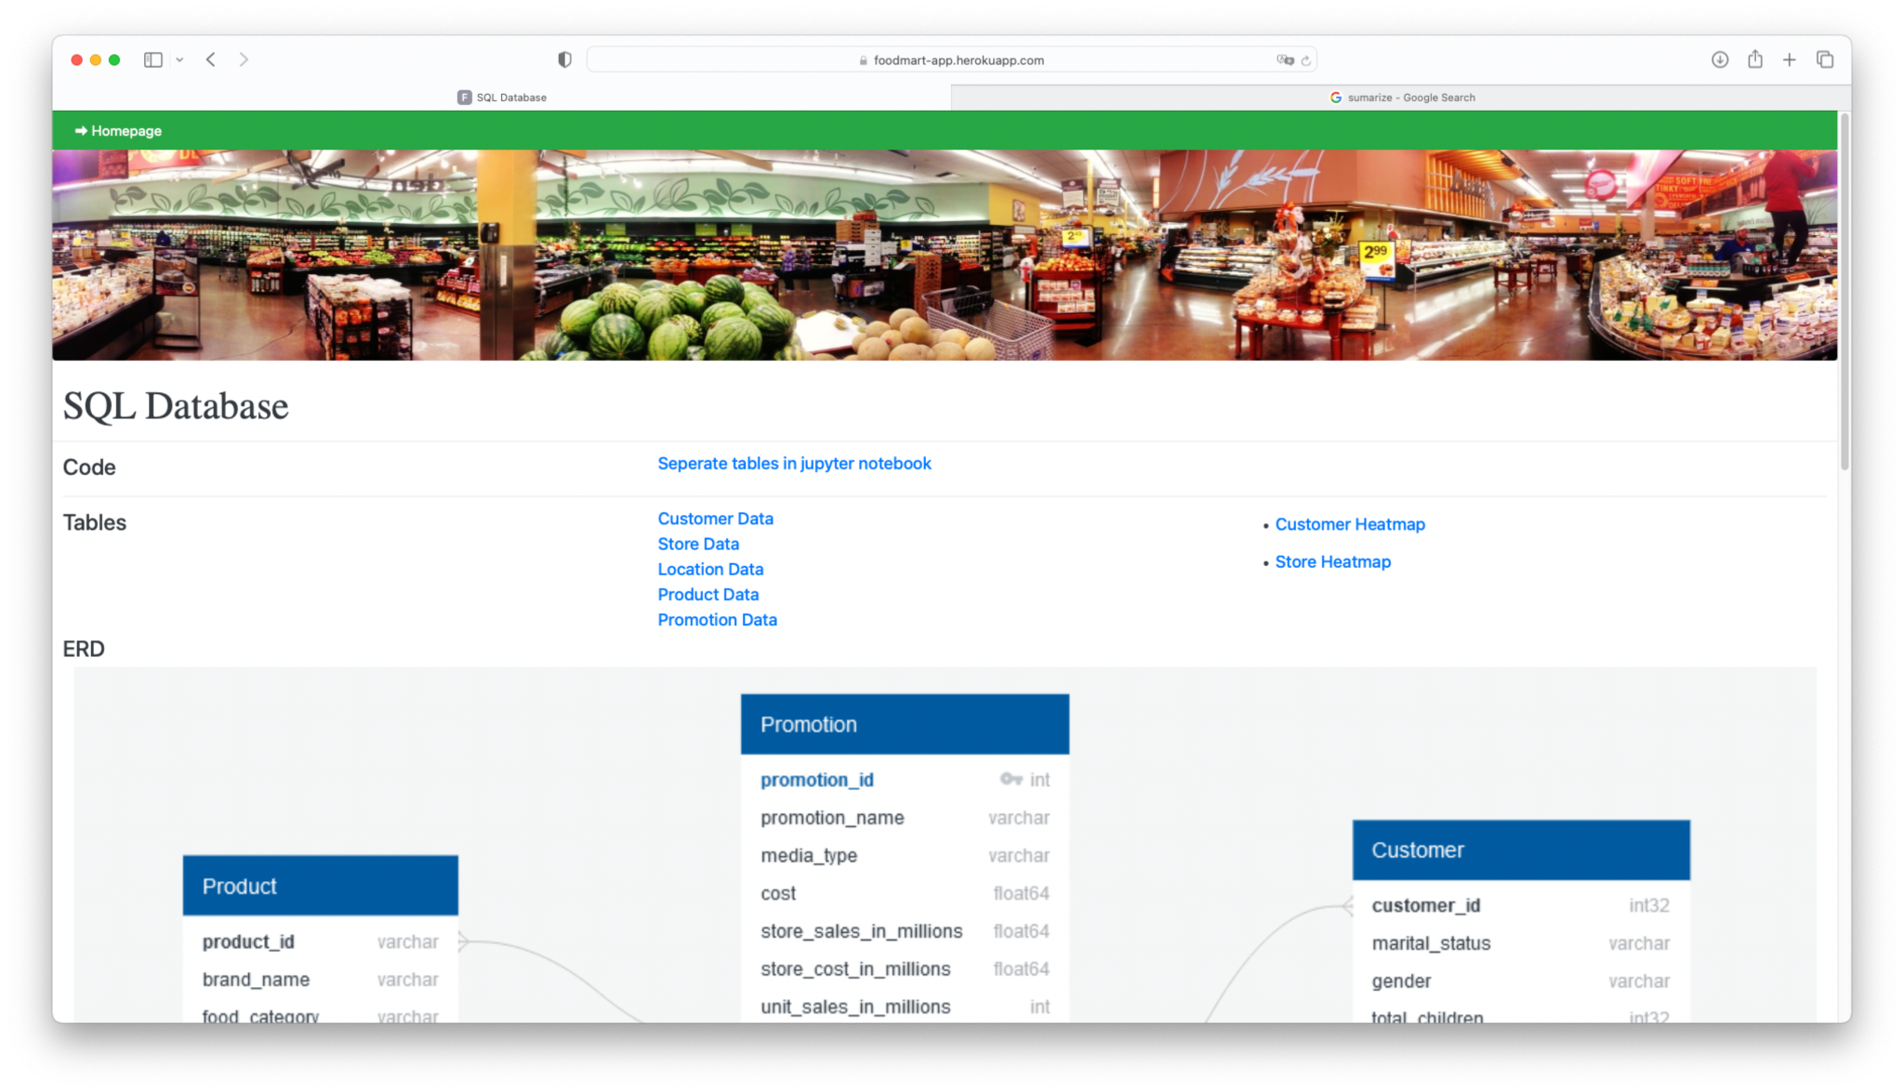
https://foodmart-app.herokuapp.com
Webpage library
Notes:
Further, we divided the original dataset into several tables. Let Berns to talk more about it.

Slide 7
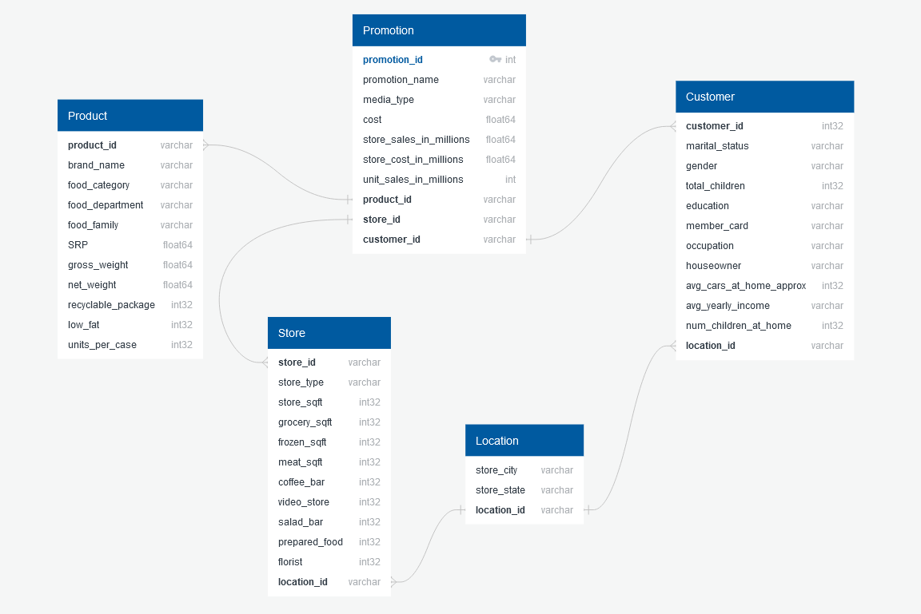
DataBase
Database : SQL
SQL - > Jupyter Notebook
5 Tables
Joins to create new Tables
Foreign Key Columns

Slide 8
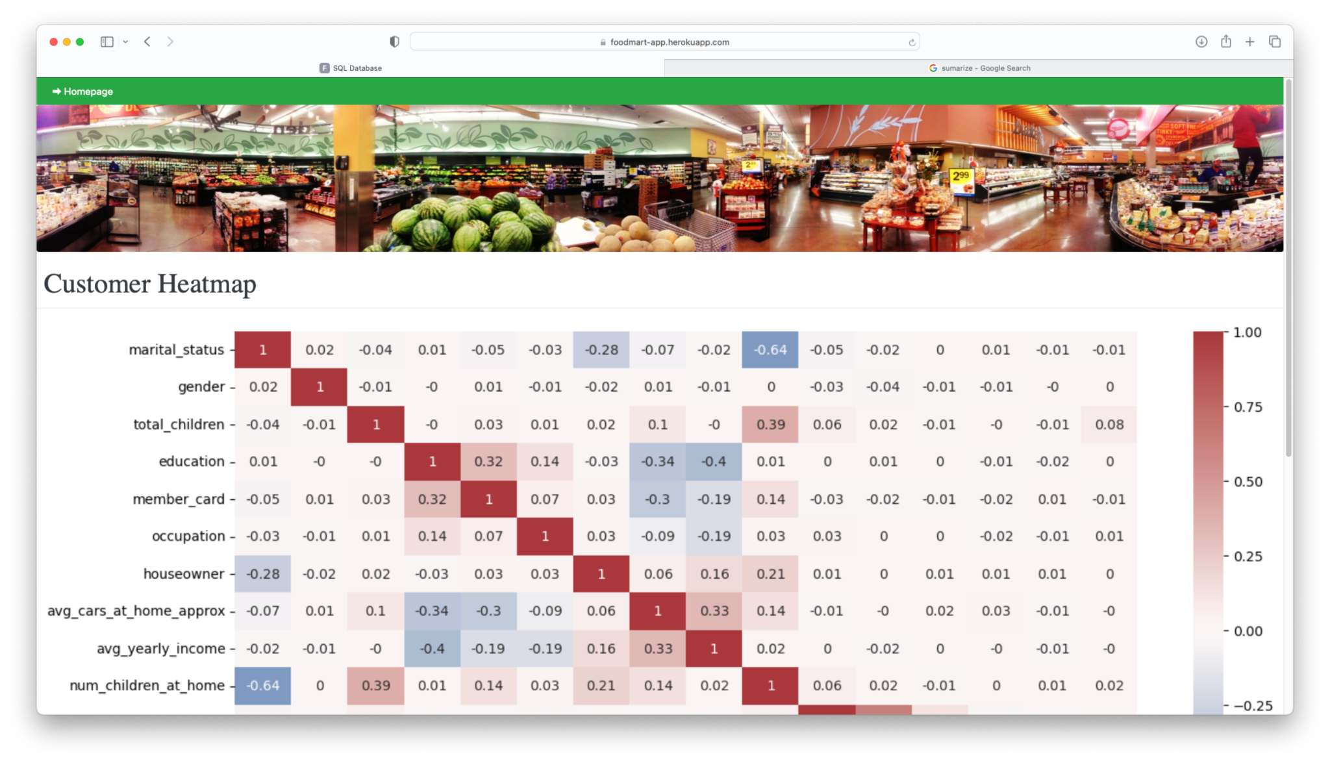
https://foodmart-app.herokuapp.com
Webpage library
Notes:
For separated tables, we discovered the feature correlations. Either for customer or the store table, features show very weak correlations between each other.

Slide 9
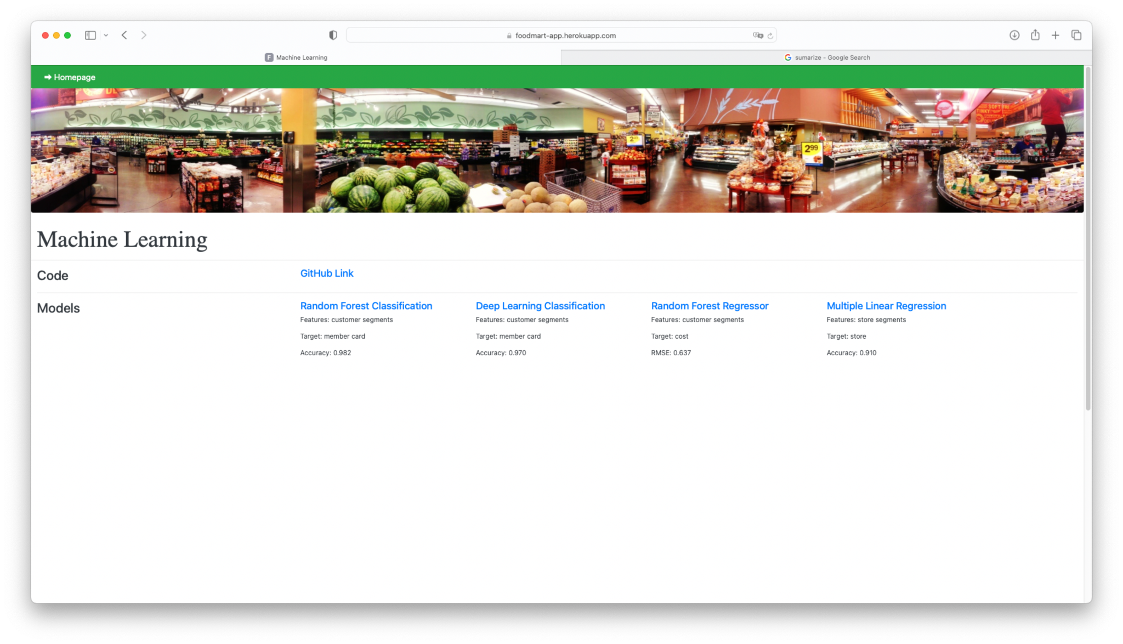
https://foodmart-app.herokuapp.com
Webpage library
Notes:
So we explored dataset with some machine learning to give us more insights on prediction of store sales, media cost, customer member card.
Gian will throw us a mind storm of his results.

Slide 10
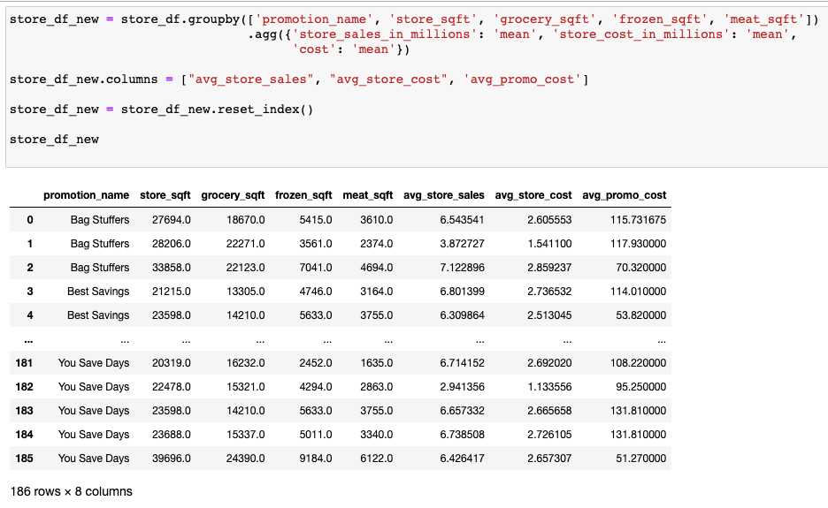
Machine Learning Overview
Having tested several models, RandomForest Classifier & RandomForest Regression proved the best performers for our dataset
1
Aggregation Example
We explored grouping & aggregating variables in our ML models to positive effect
2
KMeans was not viable. Our dataset refused to cluster
3

Slide 11
Machine Learning Findings
The Cost of a Sales Promotion’s is strongly linked to customer demographics
Store characteristics such (square feet, store cost, coffee bar, etc.) were strong predictors of store sales
1
4
Membership card Tiers are strongly linked with customer demographics as well
2
5
A promotion’s media type could not be predicted using customer demographics
3
There’s no relationship between different promotions (ie: Bag Stuffers, You Save Days, etc) and the type of product sold.

Slide 12
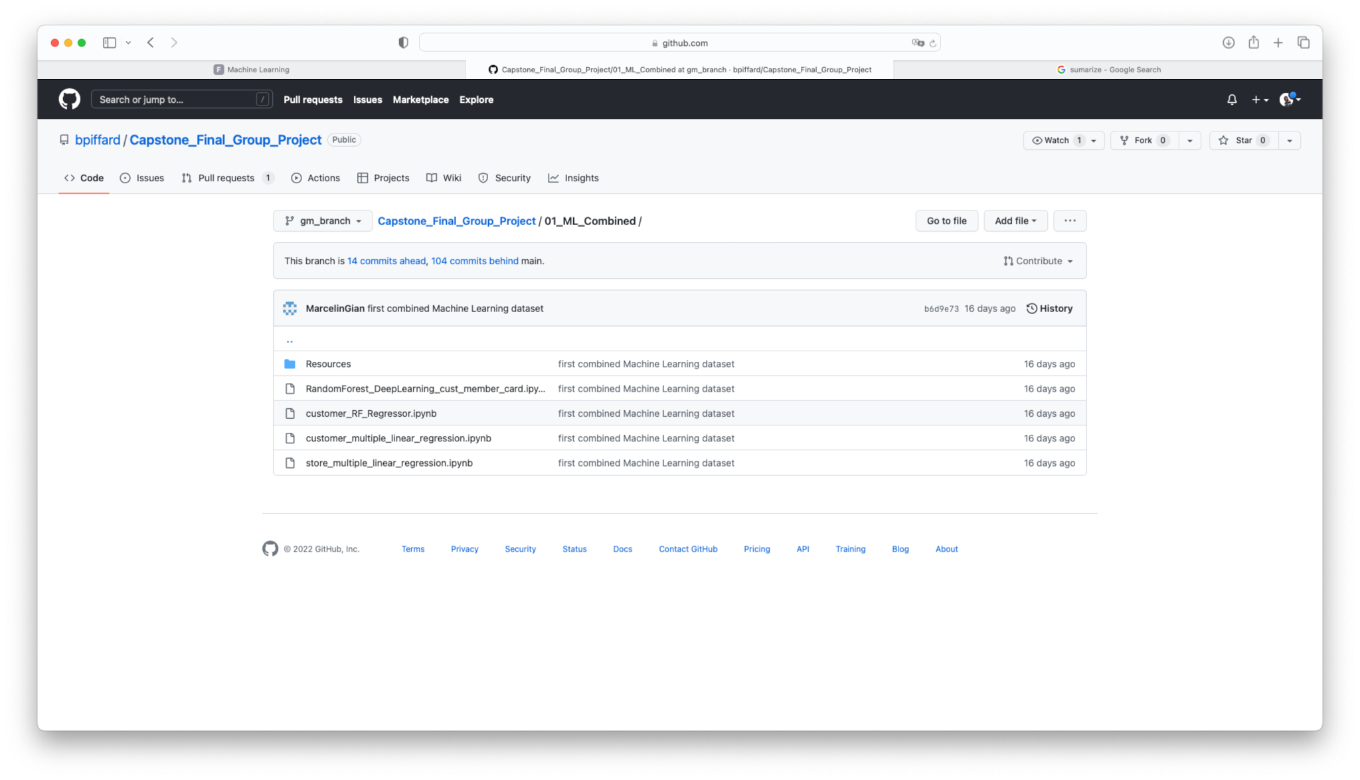
https://foodmart-app.herokuapp.com
Webpage library
Notes:
The machine learning codes have been uploaded to our github repository.

Slide 13
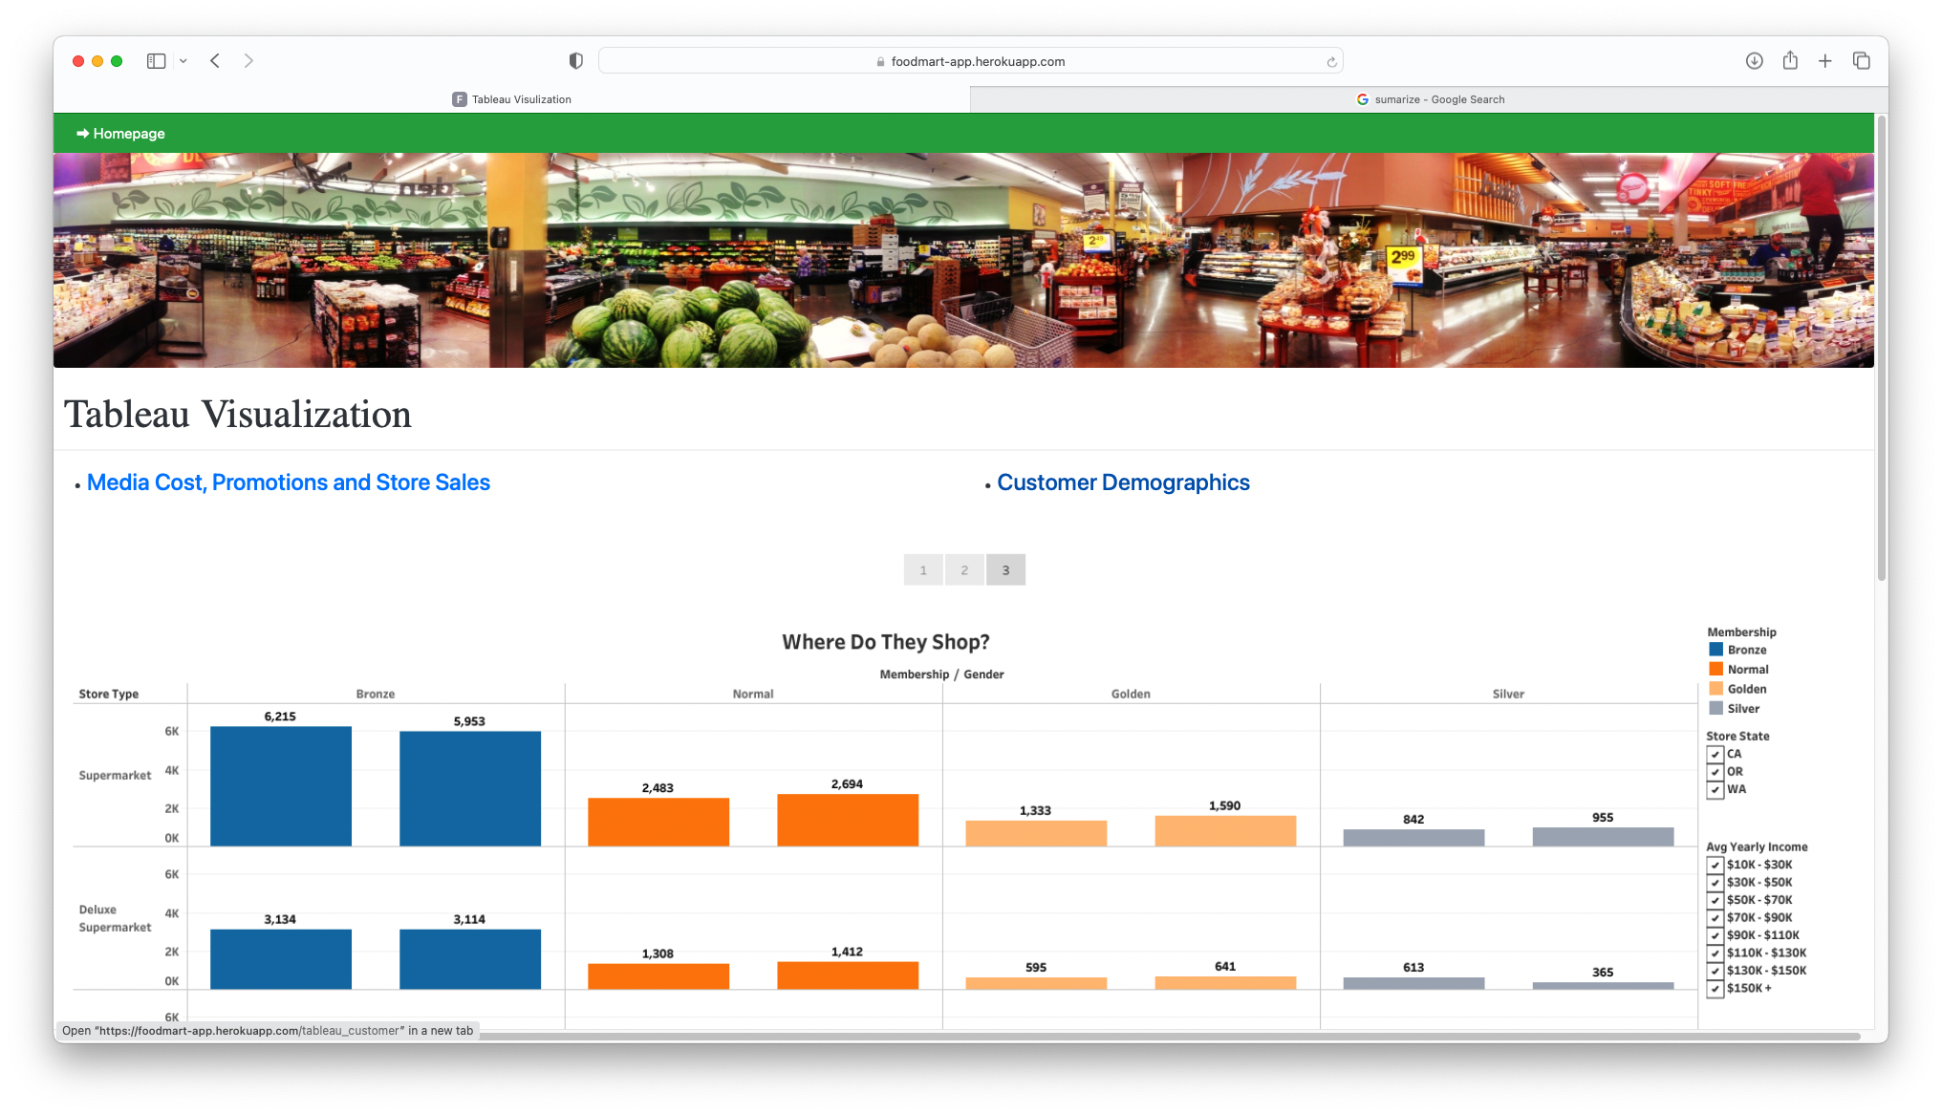
https://foodmart-app.herokuapp.com
Webpage library
Notes:
Carlos broke down customer segments for us. Let learn more about it with him.

Slide 14
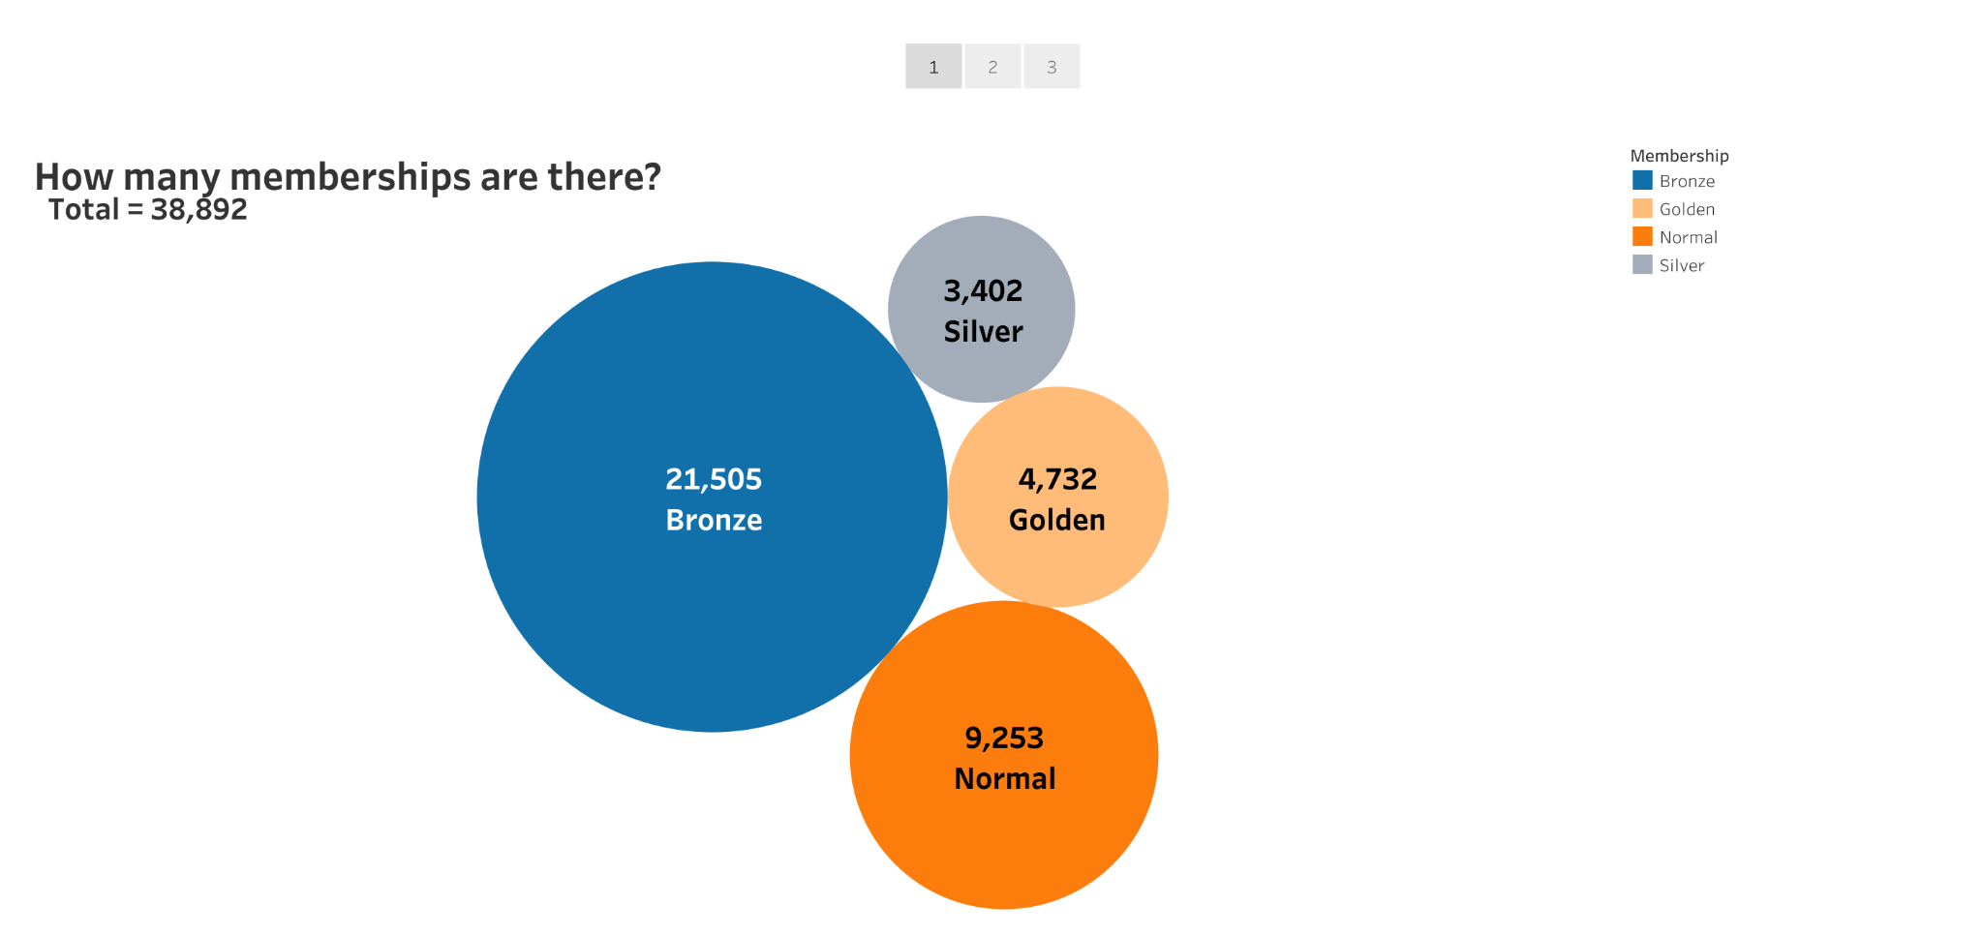
Data Visualizations
Notes:
First, we wanted to know how many total memberships were in each category. This was important to us to because we wanted to know the total number of memberships that this data set consisted of.
This was accomplished by taking the sum of the total memberships and dividing it by the number of different types of memberships.

Slide 15
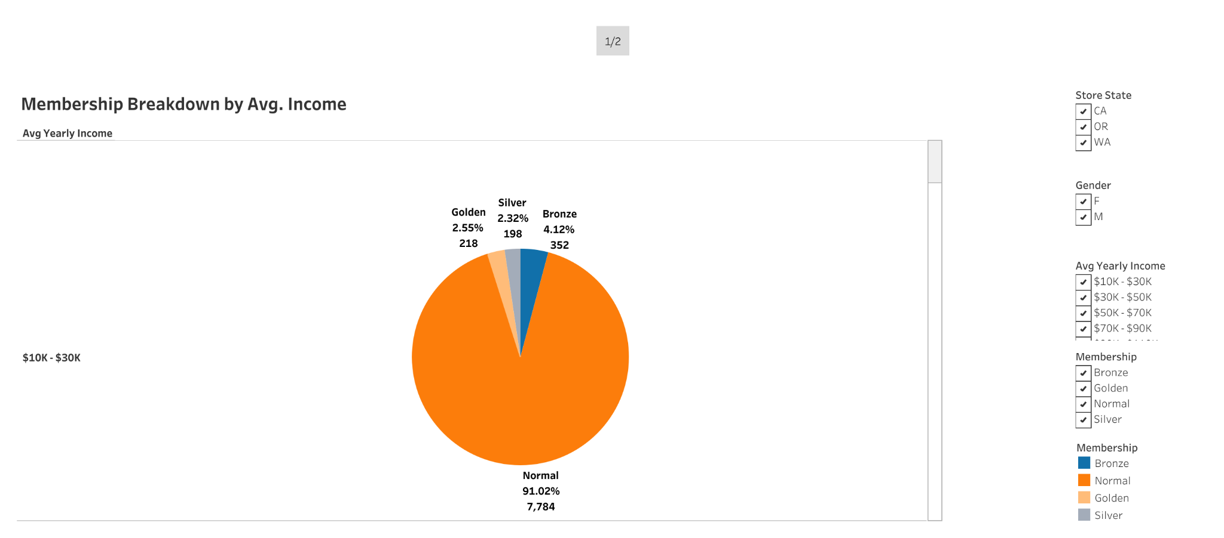
Data Visualizations
Notes:
We decided it was important to see what the customer demographics were so we can determine which segment to target
We addressed this problem by creating several pie charts. We decided on this type of visual because it helped organize and show the data as a percentage of a whole as well as helped us compare the relationship between different dimensions. In this case, we used Gender and Avg. Income within the specific contexts of States.
With the filters that were implemented, this led to us finding out which groups were overrepresented and underrepresented.

Slide 16
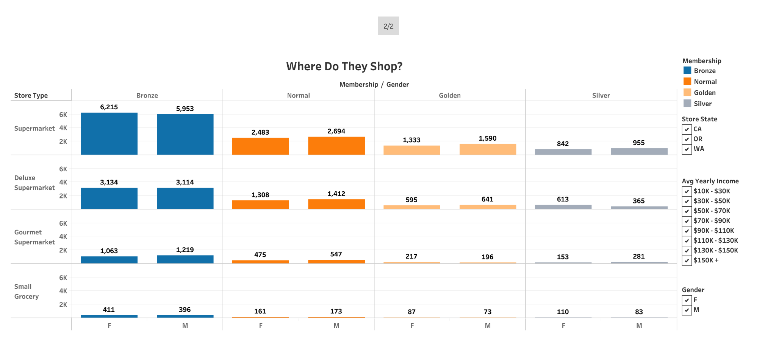
Notes:
After discovering who made up our demographics, we decided it was important to find out where they shop so we can target that segment.
We tackled this question by creating a bar graph showing where these customers shop based on their membership status and gender.
We also filtered out the data to include all states and all avg. incomes.
While the graph was being assembled, we discovered that the majority of customers, regardless of gender, avg. income, or member status, shopped mostly at “Supermarkets”.
This led us to the next part of the visual analysis

Slide 17
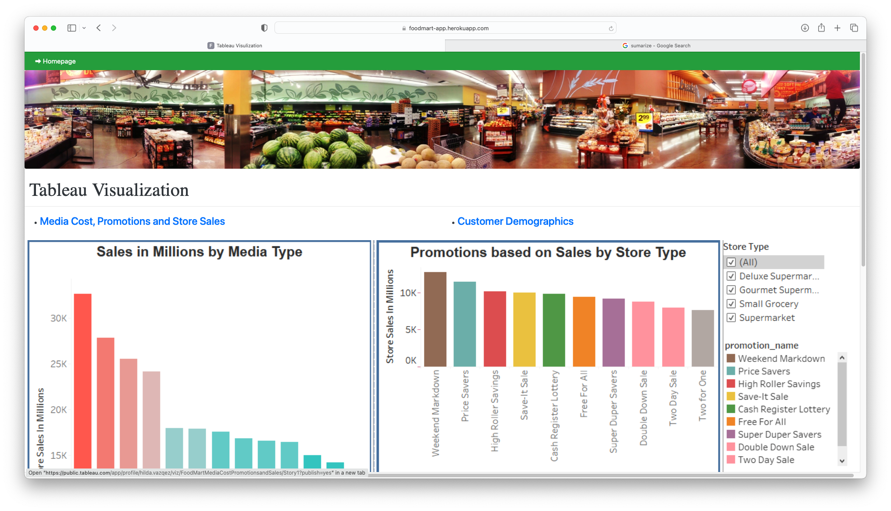
https://foodmart-app.herokuapp.com
Webpage library
Notes:
Additionally, we used tableau to visualize the inside factors of media cost, promotion and store sales. Hilda will explain more details for us today.

Slide 18
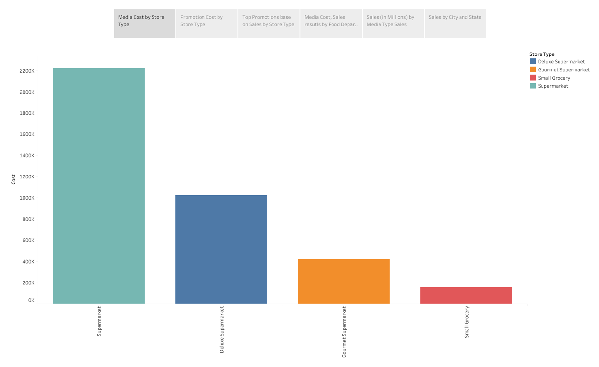
Food Mart Media Cost, Promotions and Sales
Notes:
As it shows on this Media Cost by Store Type graph, “Supermarket” is the priciest type of store, which coincide with the prior chart where more customers shop.

Slide 19
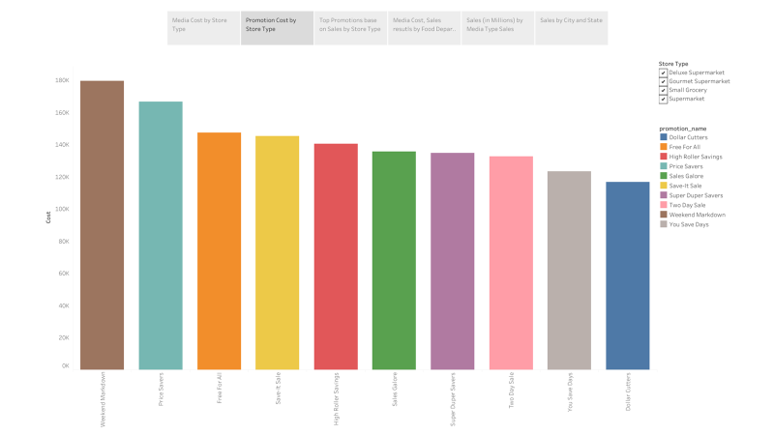
Notes:
There is total 49 promotions, however on this graph I am showing the highest costly promotions. Filter by store type to show.

Slide 20
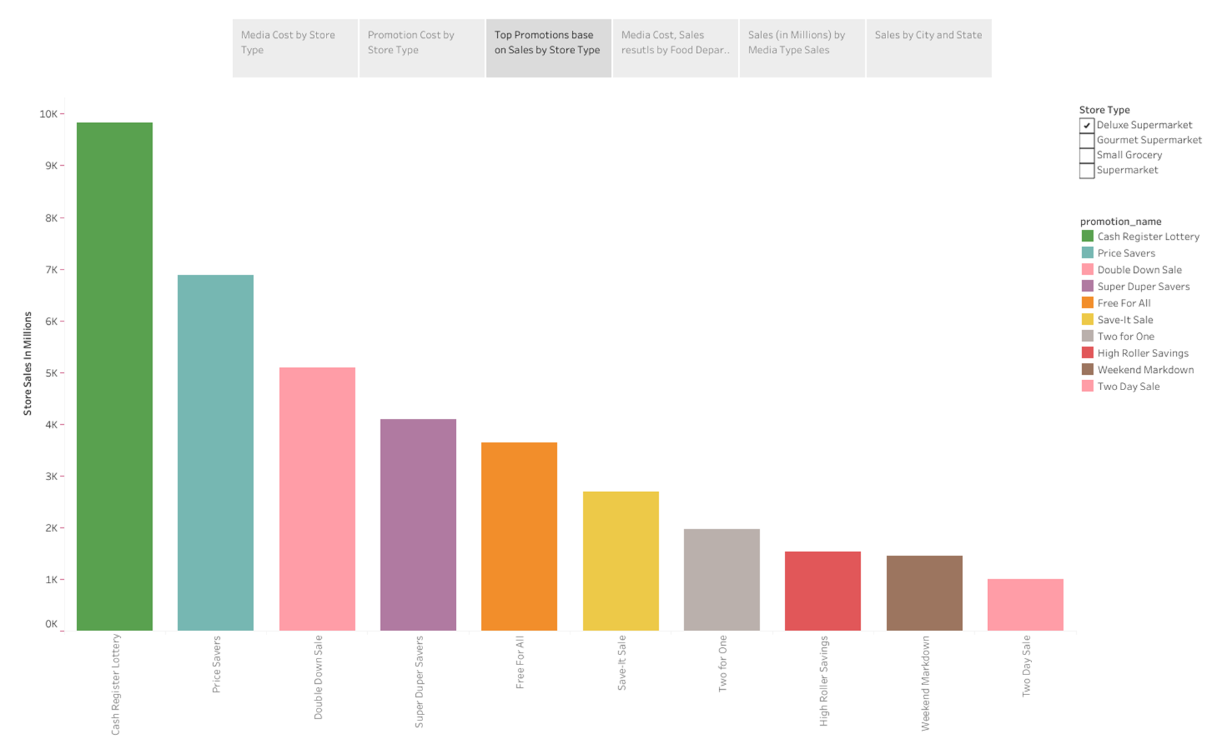
Notes:
Top Promotions, Weekend Markdown is the most profitable. However, it varies by store type. Filter and how.

Slide 21
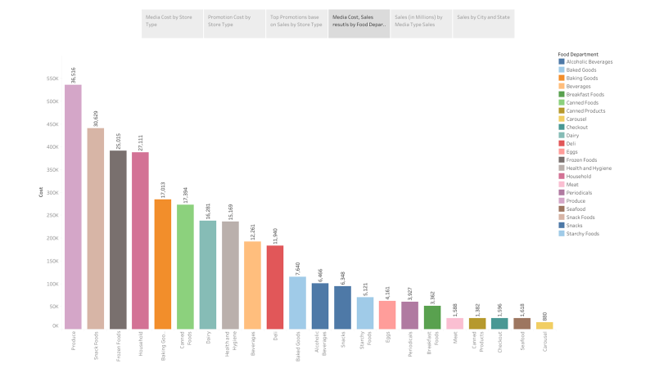
Notes:
This visualization shows the media cost and sales results by Food Department, as we can see Produce is the one with the highest cost of media but also it has a high impact on sales. Show Frozen foods and Household bars the promotion could be costly but different impact on sales.

Slide 22
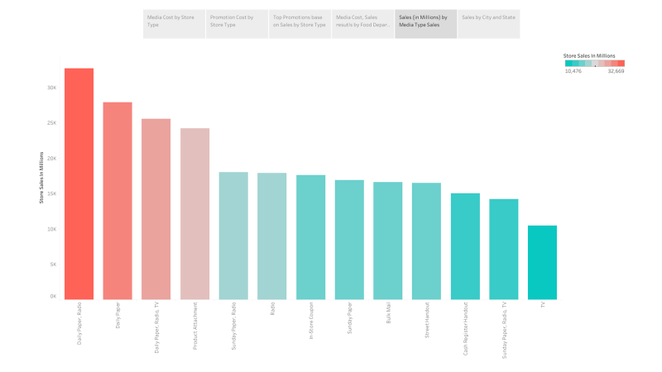
Notes:
What are the total sales by media type? As this graph shows, “Daily paper, radio” has the highest sales, followed by “Daily Paper. Media type could be more cost efficient combined then buying it individually with still good sales results.

Slide 23
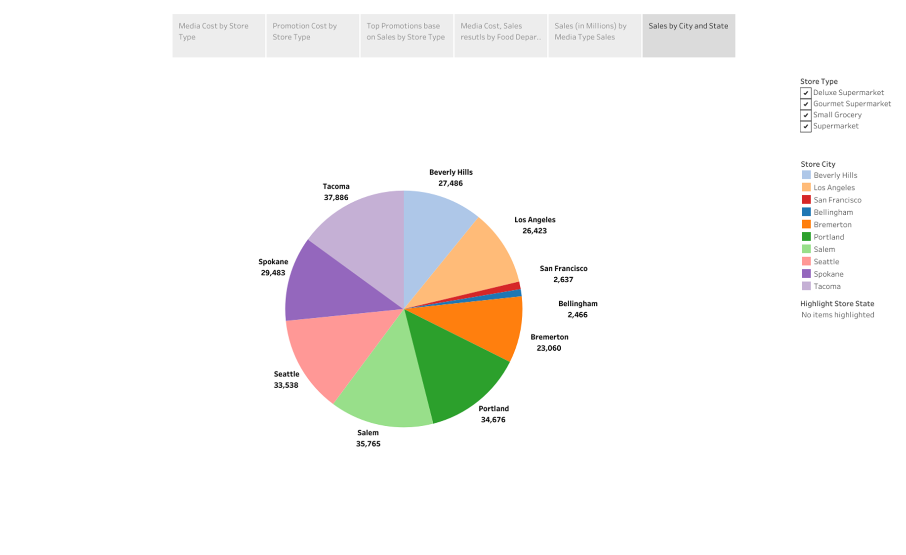
Notes:
Additionally, we have the City and State Sales results by Store type. Filter and show.

Slide 24
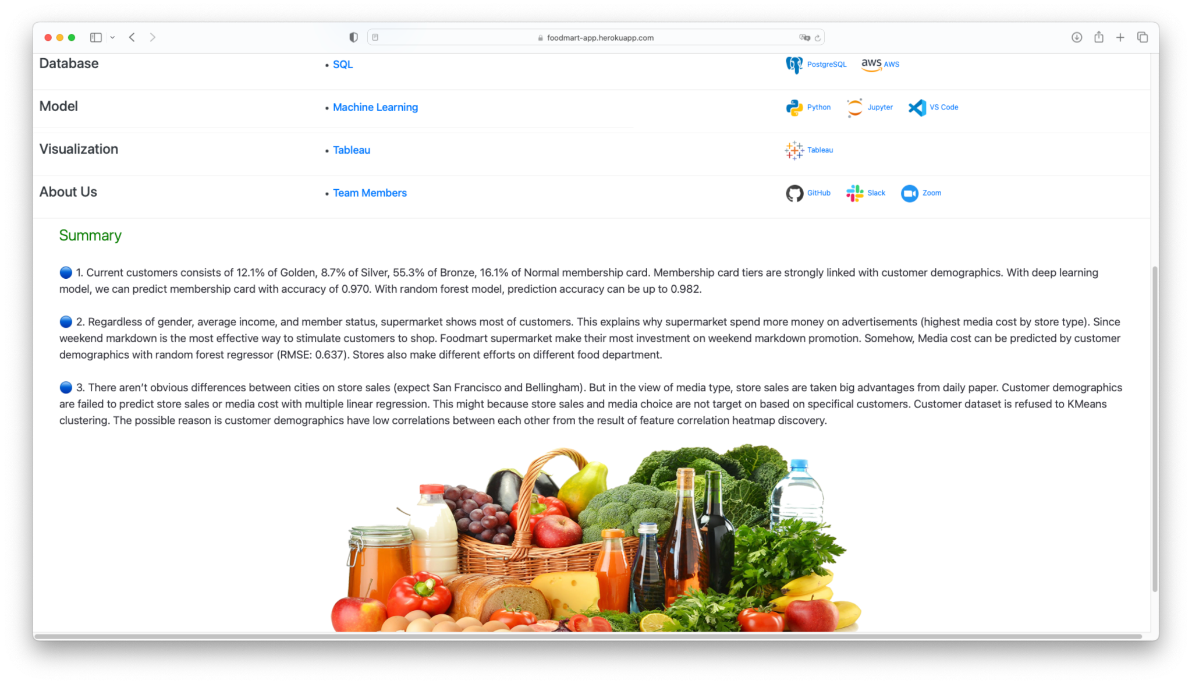
https://foodmart-app.herokuapp.com
Webpage library
Notes:
Our analyses results are shown on our webpage too. Please refer to the link that we send on the chat to get more information.

Slide 25
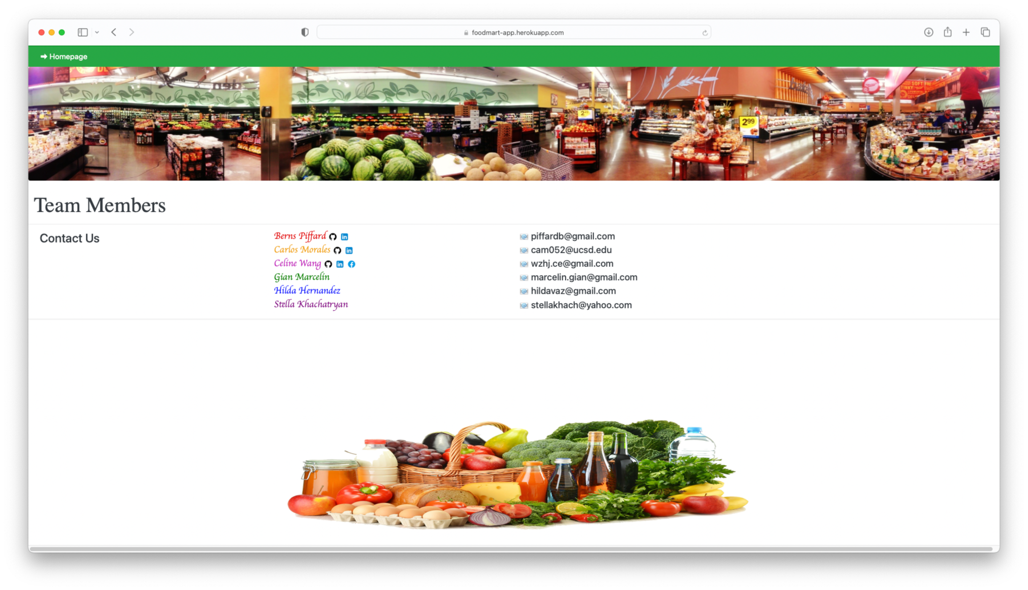
https://foodmart-app.herokuapp.com
Webpage library
Notes:
Thank you for your attention.
If you are interested in our project or have any questions or suggestions, please feel free to contact us.

Slide 26
Team
Stella Kahachatryan
Gian Marcelin
Carlos Morales
Berns Piffard
Celine Wang
Hilda Hernandez
CFO
Sales Director
CEO
Vinny Viewer
Wendy Writer

Slide 27
Thank you.

